Slide 1
Lectures in econometrics Hypothesis testing
K foster
These narrations accompany lecture notes online. We will be applying these in class so please listen to and/or read the notes before class.

Slide 2
Hypothesis testing
basic question is "How likely is it, that I'm being fooled?"
“What if there were actually no relationship?”
Null Hypothesis, H₀
Alternative Hypothesis H_{A}
Can set rules for judging even before looking at the data
The question, "How likely is it, that I'm being fooled?" is p-value – the likelihood that there could be no relationship in the data but it would look like there’s something there
Usually 5%
Either the data allow us to reject the null hypothesis or not reject the null
Never “accept” the null

Slide 3
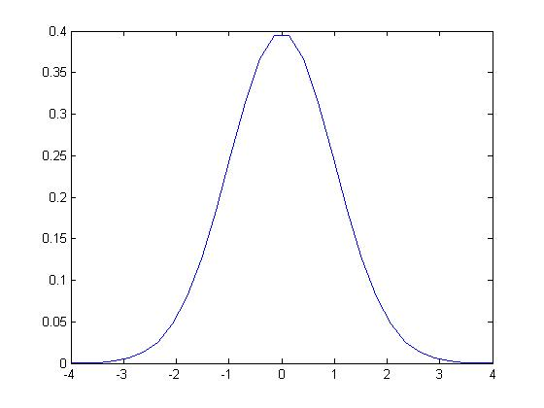
Mechanics of hypothesis testing
Null hypothesis is often that a parameter is zero
Z-statistic for sample average
Assuming the null hypothesis is true, sample average would have normal distribution
So $\frac{\overline{x}}{se}$ has standard normal distribution
From standard normal, calculate p-value as area beyond calculated Z

Slide 4
Other versions of test
If testing $μ=0$ at 5% p-value, then do not reject if $\frac{\left|\overline{x}\right|}{se}<1.96$
Same as$\left|\overline{x}\right|<1.96∙se$ or $−1.96∙se<\overline{x}<1.96∙se$
Range gives Confidence Interval (CI)
If test against another parameter value not zero, $Z=\frac{\left|\overline{X}−μ_{null}\right|}{se}$
So CI is $\left(μ_{null}−1.96∙se,μ_{null}+1.96∙se\right)$
Alt, convert Z-value into p-value by finding the area of normal distribution beyond that value

Slide 5
Type I and type ii error
 | Null Hypothesis True | Null Hypothesis False
Test does not reject null |  | Type II
Test rejects null | Type I
P-value gives probability of making Type I error
Cannot control level of Type II since we don’t know how far null hypothesis is
As in all of economics, there is a tradeoff
(examples in notes)

Slide 6
Complications from a series of tests
Since always at risk of error of Type I or Type II, a series of tests that depend on each other is more likely to introduce error
Remember example from earlier in class: even if there is just a 5% chance of any single escalator not working, the likelihood of getting from ground floor to 6th floor on functioning elevators is not 95% but around 77%
“P-hacking” is doing multiple tests until find a p-value < 5% -- on average need about 20 tests to get that
Many situations have lots of data so lots of possible tests

Slide 7
Complications of tests, cont…
Don’t get so caught up with hypothesis testing machinery as to lose the point
Computer will obediently throw up lots of p-values and test stats, which is convenient! But should be a complement not a substitute for analyst thought

